Slide 1
The following presentation is incredibly stupid and may cause you to lose at least 5 IQ points. The show will begin in 5 seconds.
You have been warned!!

Slide 2
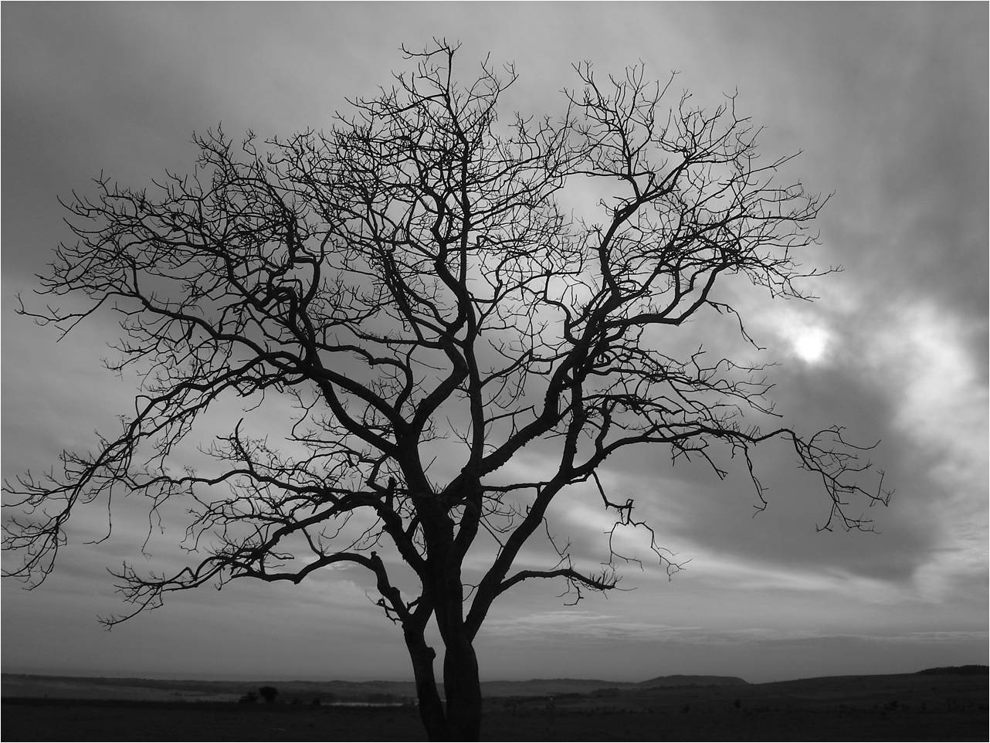
Everything will flow smoothly, please do not press anything. Thank you
Enjoy!

Slide 3
!!

Slide 4
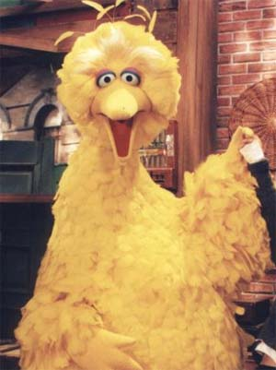

Who did this?!

Slide 5
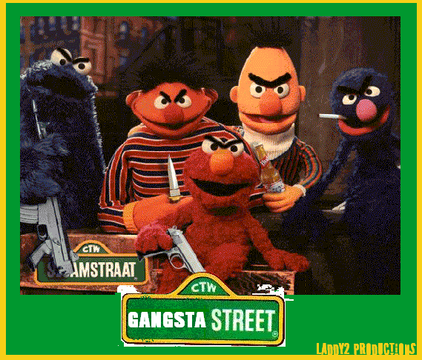

Slide 6
Stik Vs, Stik

Slide 8


Slide 9
*beep*

Slide 10
The end
=D

Slide 11
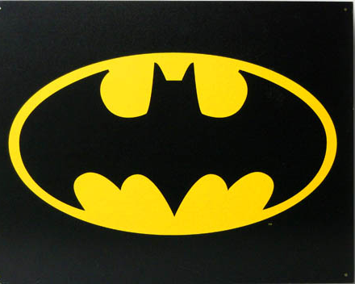
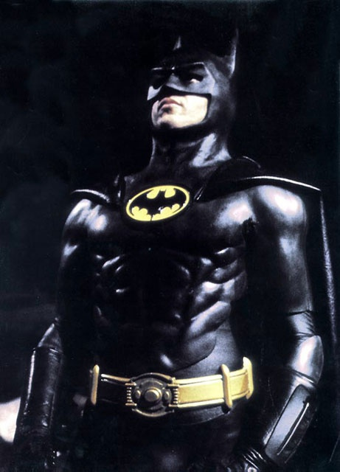
I lied! mwuahahahaha

Slide 12
WARNING!
Weird chicken dancing!

Slide 13
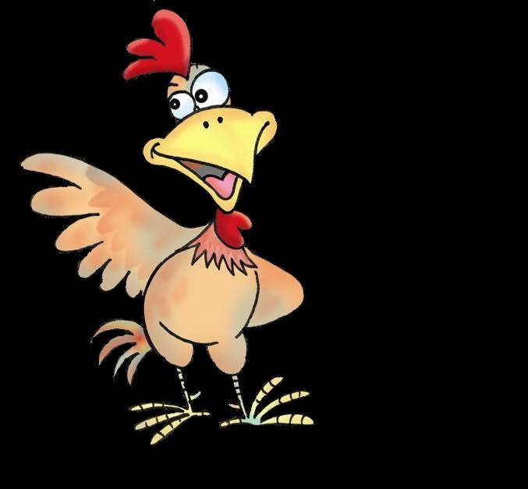
♪
♪
♪
♪
♪
♪

Slide 14
And now, a lesson in color mixing

Slide 15
Red + Blue=
Purple!

Slide 16
Jack in a box! ☺
Jack
Jack

Slide 17


Slide 18
The End!

